Slide 1
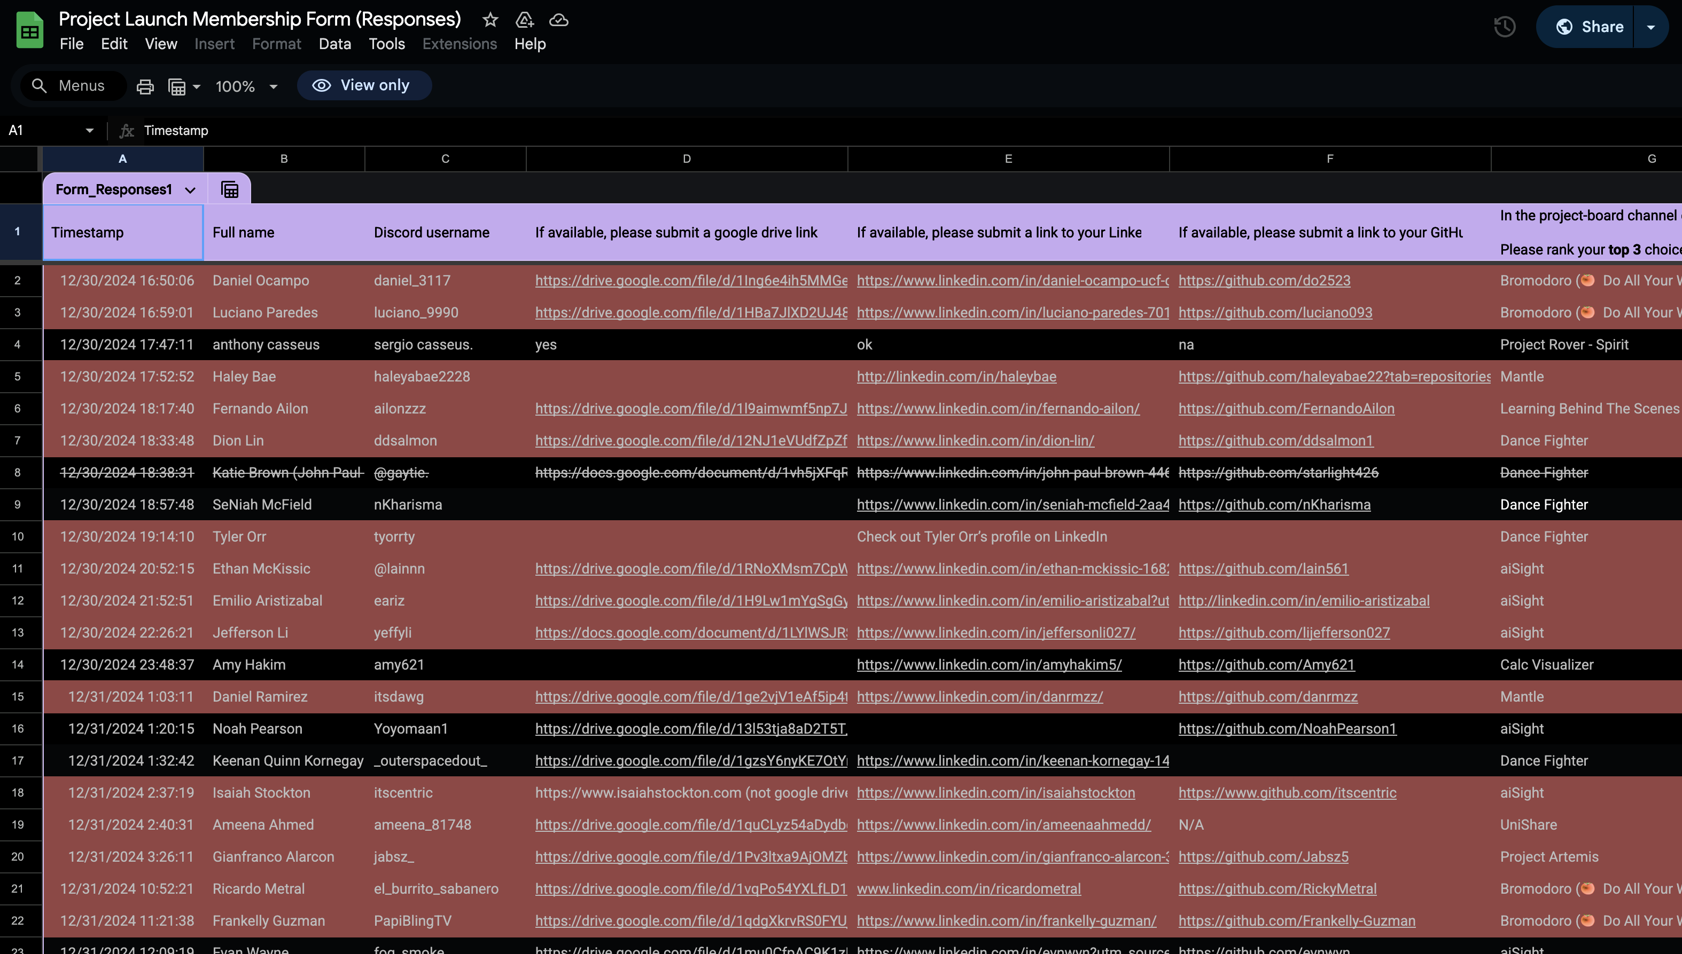

Slide 2


Slide 3
Overhiring
Economy
AI
Competition!

Slide 4


Slide 5

What do you do?

Slide 6

The first step...

Slide 7

The first step...
Is to realize that you suck.

Slide 8

Industry Engineer
You

Slide 9
But it's ok...
You won't suck forever!

Slide 10


Slide 11
But how the f#@k do you build Rome?

Slide 12
Learn how to learn.

Slide 13
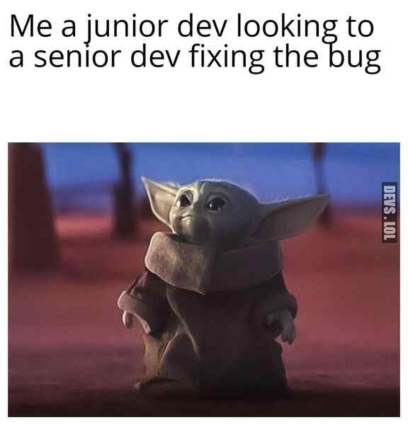

Slide 14
Enthusiastic and skilled learners are engineers who thrive.

Slide 15
Enthusiastic and adaptive learners become engineers who thrive.
( But how I do dat? )

Slide 16

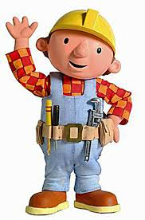
Build, build, build...

Slide 17
Build, build, build...
New framework
New language
Crazy project

Slide 18

Document it!

Slide 19
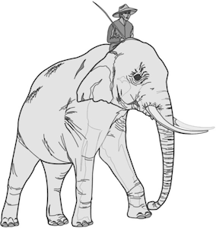
Learn fast....
And slow.

Slide 20

Practical Break!
Let's build a resume with
!!!

Slide 21


Slide 22
Document it!
Write blog posts
LinkedIn posts
Share your learning
And thinking!

Slide 23
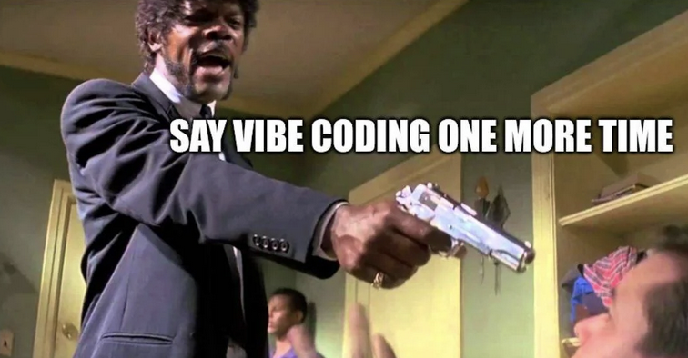
Use AI wisely!

Slide 24

Don't oversell yourself...

Slide 25

...But do BE yourself!

Slide 26

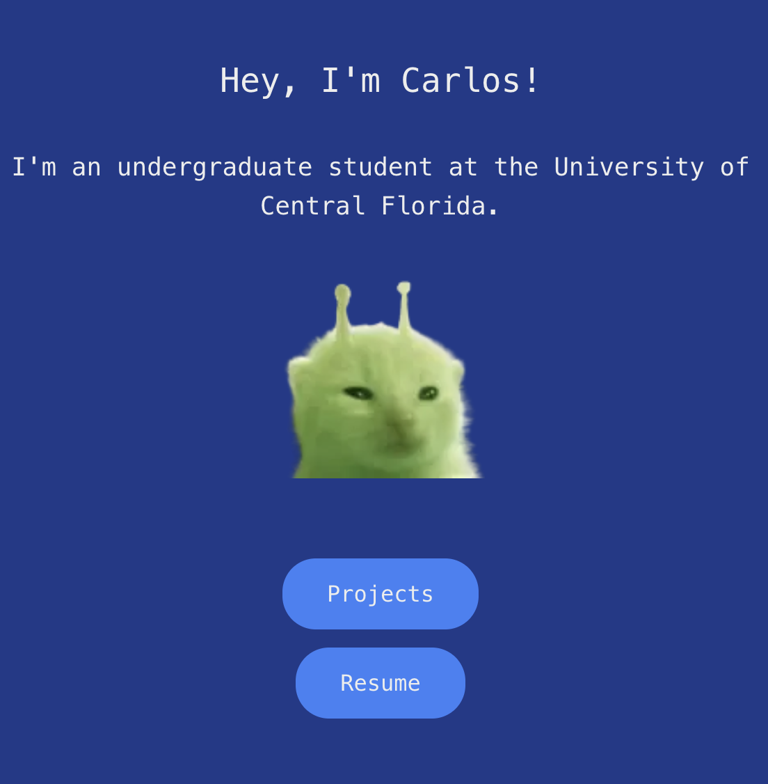
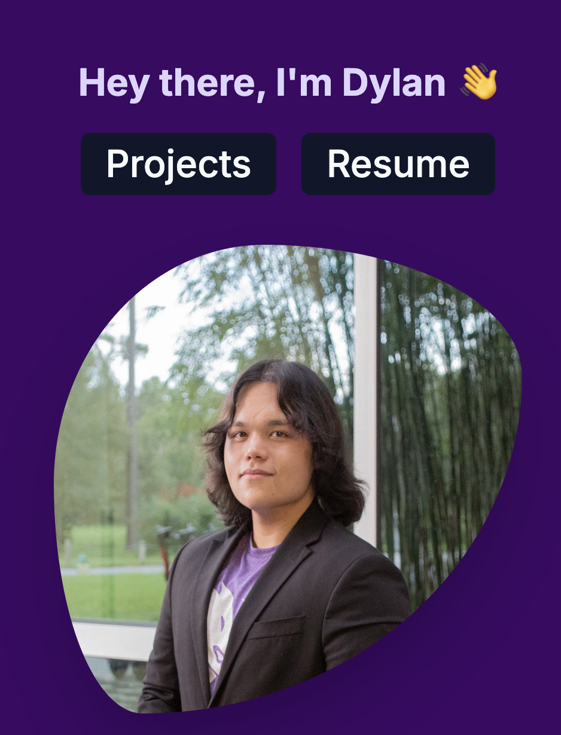

Build a brand...
...Do what you know!

Slide 27


Practical 2!
Let's set up a simple portfolio site with
and

Slide 28

DONT FORGET...

Slide 29

It's gonna be ok :)

